Slide 1

Designing a computer program that creates a 3D wire-frame model from a laser scan of the interior of a room
Tim Marsh
Supervisor: Dr George Sithole

Slide 2
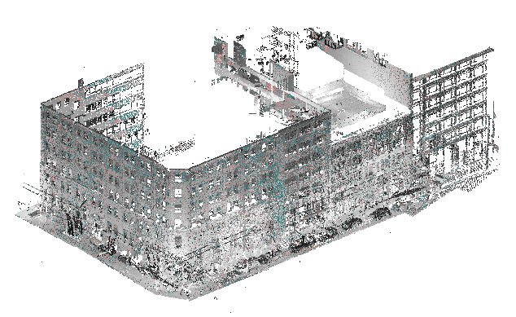
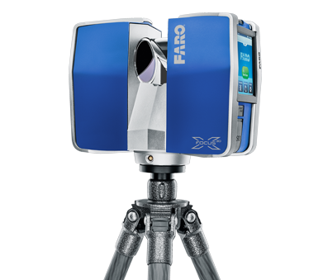
With laser scanning becoming more and more popular as a form of surveying.
Laser scanning produces point clouds which are great but not usually what a customer wants
We need to make the point cloud usable, more structured
Notes:
Intro slide
Basically prop abstract

Slide 3
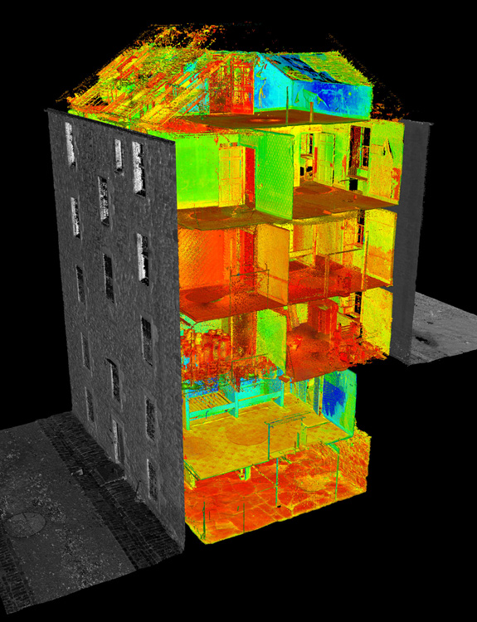
A wire-frame model is an edge or skeletal representation of a real-world 3D object using lines.
Interior of buildings are notoriously difficult to navigate as a point cloud
Creating a wire-frame model of the interior of the building makes it easier navigate or to use in a practical way.
Greatly reduces size of the model.

Slide 4
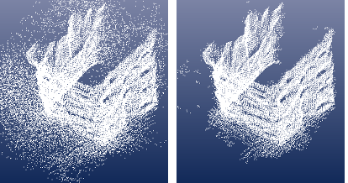
From Points to Surface
Pre-Processing
Removing Noise
Sampling

Slide 5
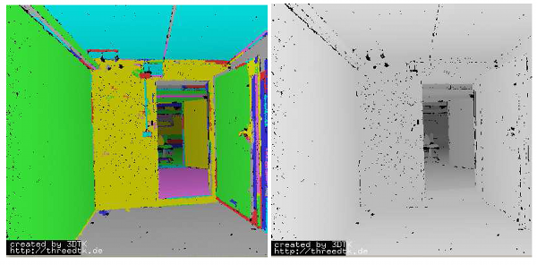
Determination of the global topology of the objects surface
Segmenting
Searching for edges

Slide 6
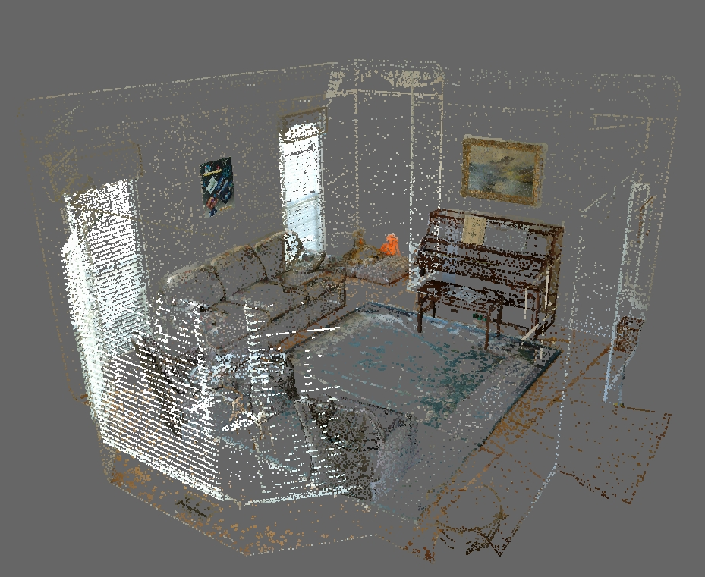
Generation of the surfaces
Triangular meshes or planes are created satisfying certain requirements e.g. size limits ect…

Slide 7
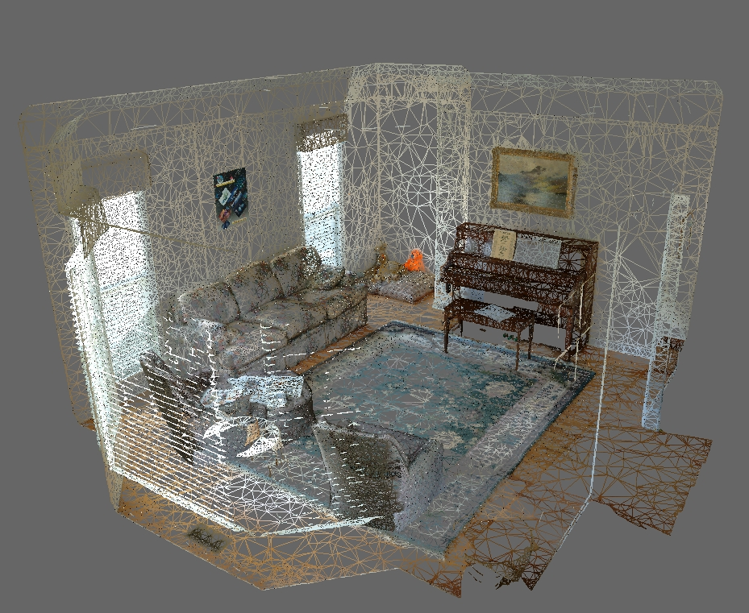

Slide 8
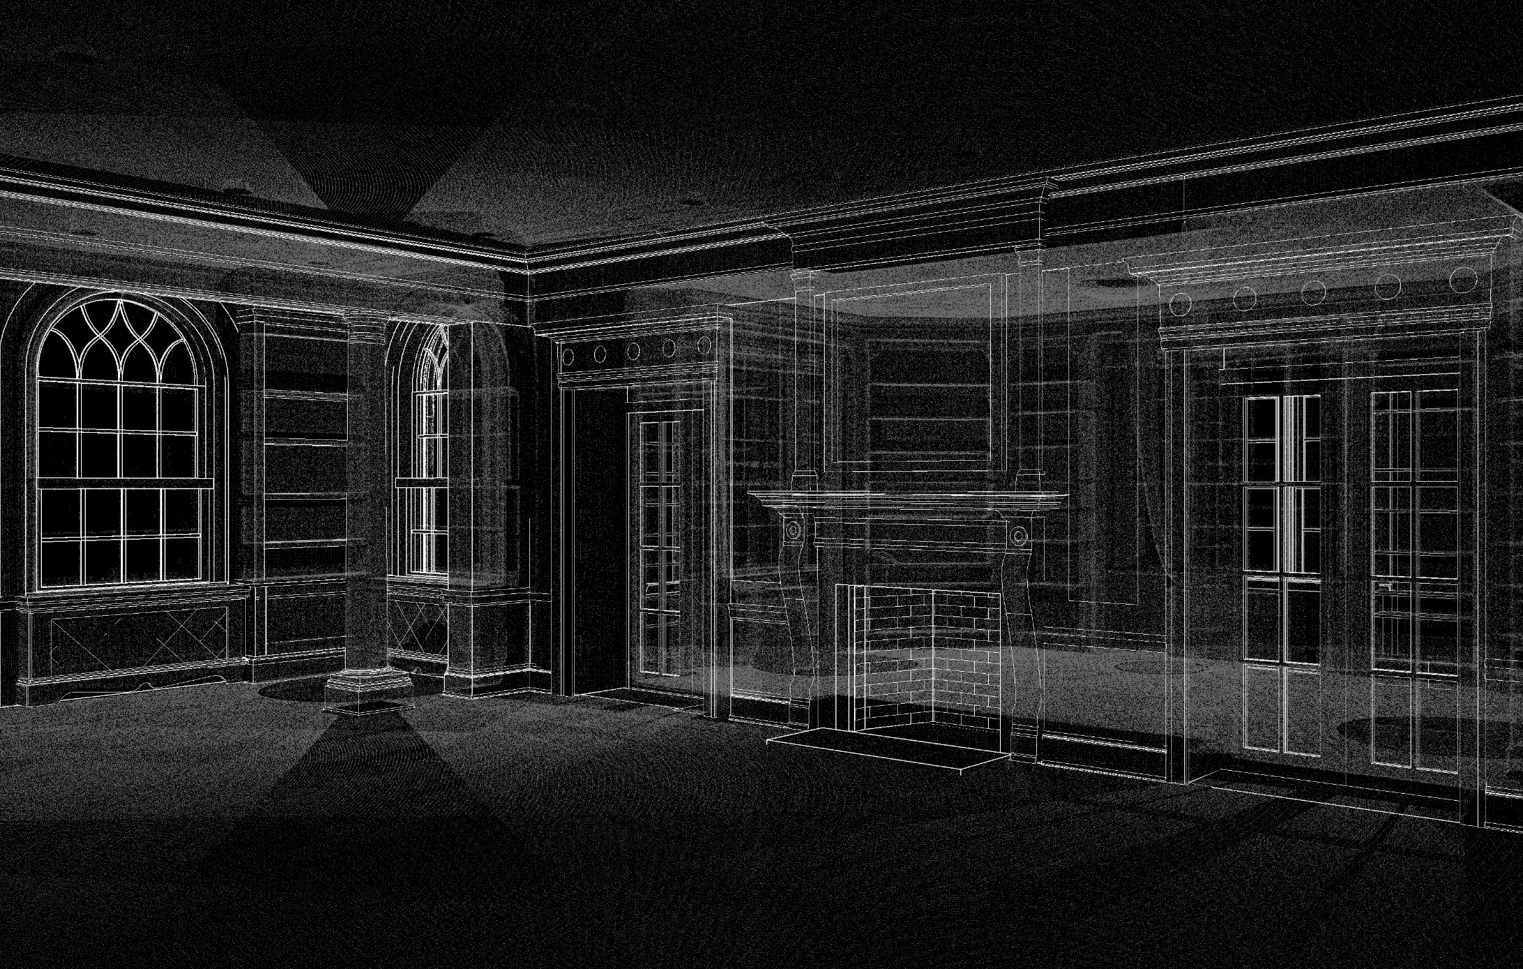

Slide 9
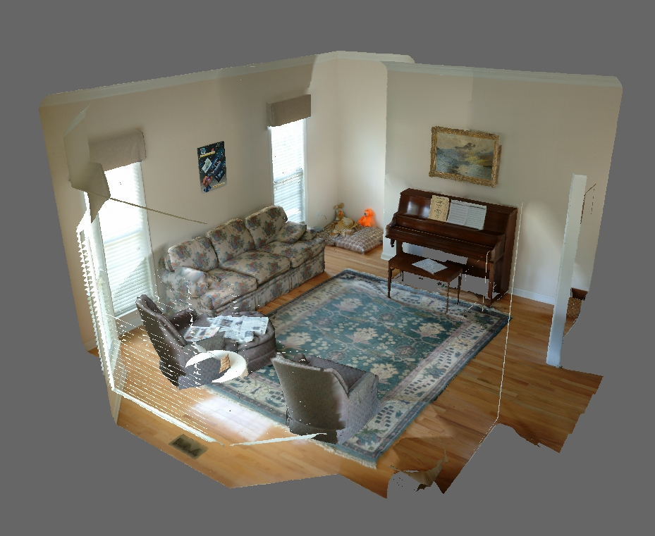
Post Processing
When the model is created, editing operations are commonly applied to refine and perfect the polygonal surface

Slide 10
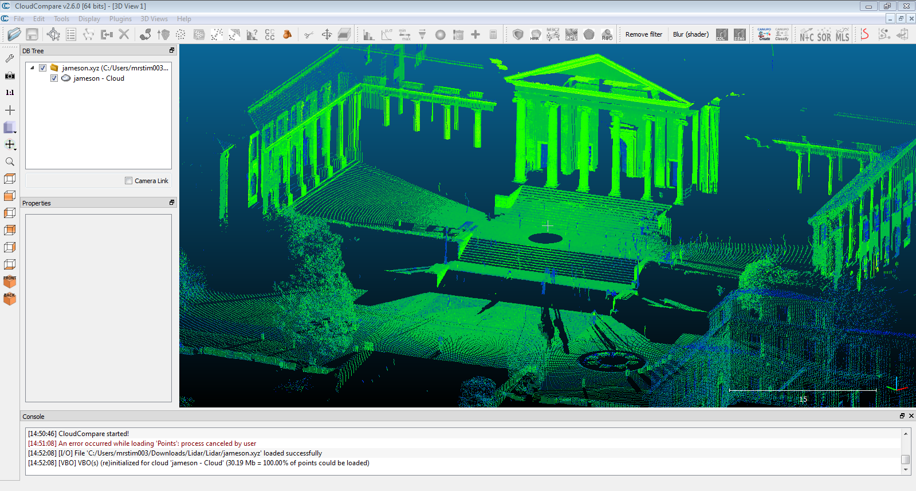
Outcomes
The outcome of this paper will be to create an automatic system that creates 3D wire-frame models of the interior of a room/rooms in a building.
The program will be created in C++ using Point Cloud Library (PCL) and then be used as an add on function for existing point cloud software.

